Slide 1
SPPS 255: Principles of Pharmacoeconomics
Bias and Confounding/Methods to address confounding
Monday, 28 April 2025

Slide 2
objectives
Define and sketch a causal diagram using directed acyclic graphs (DAG)
Explain the properties of a confounder
Identify a confounder along the DAG
Explain the methods for controlling a confounder

Slide 3

Directed acyclic graph (DAG)
A directed acyclic graph (DAG) is a visual representation of the causal relations that make the underlying relationships between factors explicit
A cause is a factor that produces an effect on another factor
A directed path is a sequence of arrows in which every arrow points in the same direction (no closed loop)
E
O
Judea Pearl

Slide 4
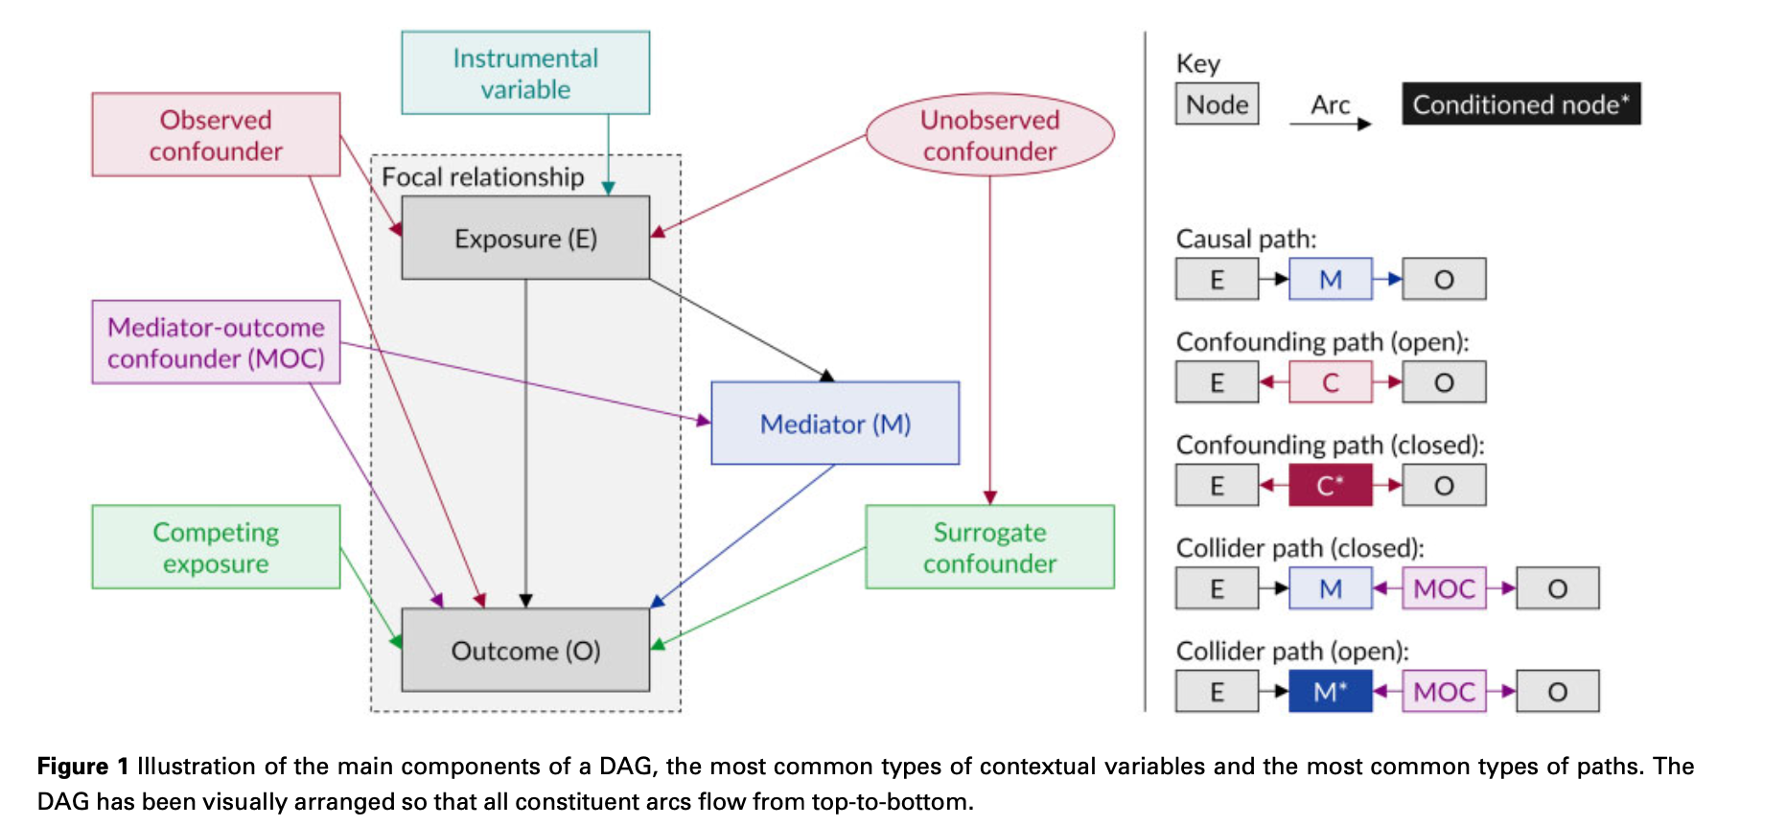
Directed acyclic graph (DAG)—Example
Tennant, et al. International Journal of Epidemiology. 2021:50(2):620-632.

Slide 5
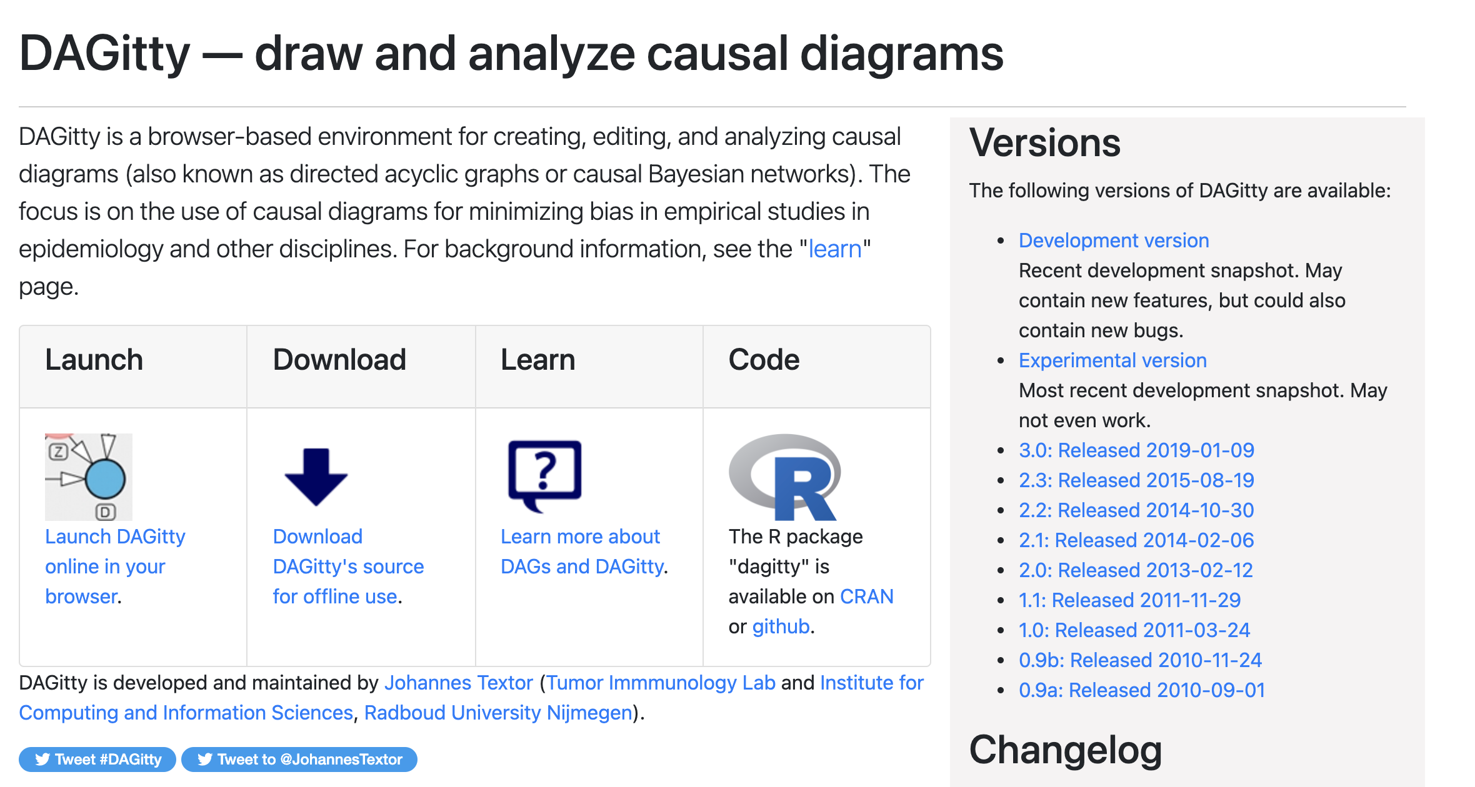
DAGitty (draw Your own dag diagrams)
http://www.dagitty.net/

Slide 6
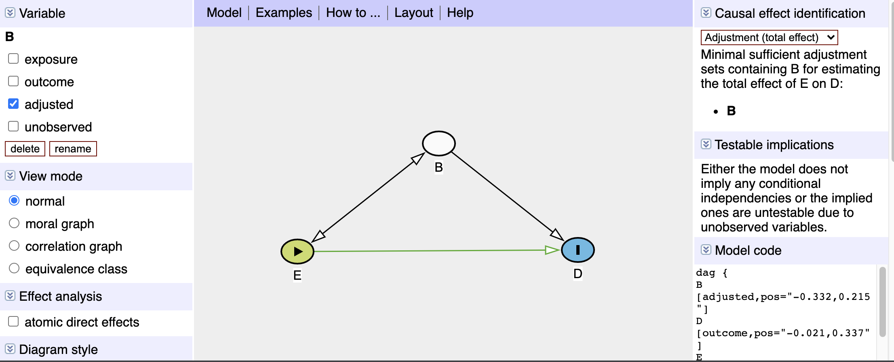
DAGitty (draw Your own dag diagrams)—confounder ex.
http://www.dagitty.net/

Slide 7
Types of biases (1)
Bias is any systematic error in an epidemiologic study that results in an incorrect estimate of the association between exposure and the health outcome.
Selection bias
Non-random sampling bias
Responder bias (Non-responder bias)
Berkson’s bias
Information bias
Measurement bias
Misclassification bias
Hawthorne effect

Slide 8
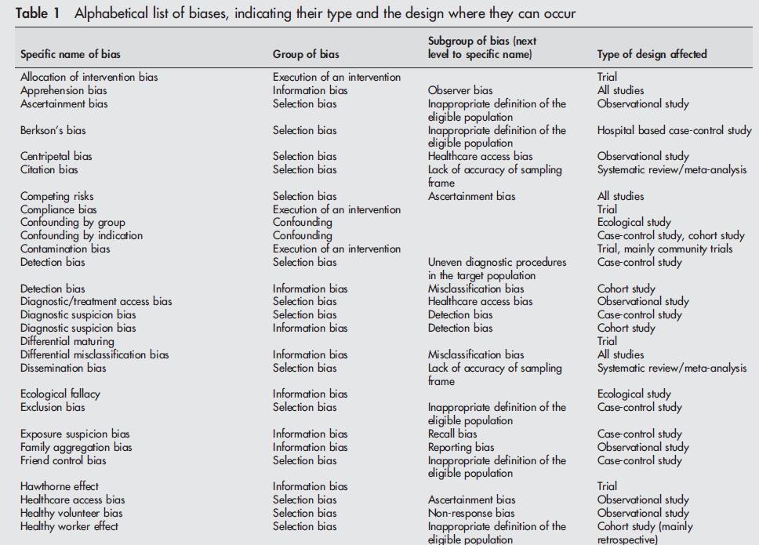
Types of biases (2)
Journal of Epidemiology & Community Health 2004;58:635-641

Slide 9
Three types of bias, thus far…
Selection bias
Non-random sampling bias
Responder bias (Non-responder bias)
Berkson’s bias
Information bias
Measurement bias
Misclassification bias
Hawthorne effect
Confounding

Slide 10
confounder
A confounder is a distortion of the relationship between the exposure and outcome; it is a factor that is associated with the exposure and the outcome but not in the causal path between the exposure and outcome
A confounder has three criteria:
Have an association with the outcome (must be a risk factor for the outcome)
Have an association with the exposure
Must not be in the causal path from the exposure to the outcome
C
E
O

Slide 11
Study design methods to control for confounding
Randomization: Eliminates links between the exposure and confounders (observed an unobserved)
Matching on the confounder: Balance the confounder between the groups
Restrict the sample: Focus on subjects with the same covariates (e.g., age, sex)
Statistical analyses: Mantel-Haenszel (MH) adjustment (stratification) and multivariable regression models

Slide 12
Motivating example: simpson’s paradox
Simpson’s paradox is a statistical phenomena where the association of two factors may be independent or reversed when stratified into subgroups
Example from Charig (1986), which treatment is better at improving survival?
 | Large stones | Small stones | Total
Old treatment | 192 / 263 = 73% | 81 / 87 = 93% | 273 / 350 = 78%
New treatment | 55 / 80 = 62% | 234 / 270 = 83% | 289 / 350 = 83%
Stone size
Surgeons were biased in their treatment selection; they preferred to treat patients with smaller stones with the newer treatment
Treatment
Success

Slide 13
Motivating example: Ice Cream and Sunburn
Let’s look at the proposed causal relationship
Does ice cream cause sunburn?
Ice cream
Sun burn
Temperature

Slide 14
Motivating example: down syndrome and birth order (1)
Let’s look at the proposed causal relationship
Does birth order cause Down syndrome?
Birth order
Down syndrome
Stark and Mantel (1996)

Slide 15
Motivating example: down syndrome and birth order (2)

Slide 16
Motivating example: down syndrome and birth order (3)

Slide 17
Motivating example: down syndrome and birth order (4)

Slide 18
Motivating example: down syndrome and birth order (5)
Let’s look at the proposed causal relationship
Does birth order cause Down syndrome?
Birth order
Down syndrome
Maternal age

Slide 19
Addressing confounding with statistics
Multivariable regression models
Linear regression
Logistic regression
Poisson / Negative binomial regression
Cox proportional hazard regression
Propensity score matching

Slide 20


Linear regression—structural form
Y-intercept
Error term
$$E\left[Y_{i}\right|X]=β_{0}+β_{1}X_{1i}+ε$$
Expected value of Y given X
Change in Y associated with 1-unit change in X
$Y_{i}$ denotes the outcome (or dependent) variable for subject i
$X_{1i}$ denotes the predictor of interest or the independent variable ($X_{1}$) for subject i
$β_{0}$ denotes the Y-intercept when $X_{1}$ is zero
$β_{1}$ denotes the slope or the change in Y with a 1-unit change in $X_{1}$
$ε$ denotes the errors

Slide 21

Linear regression—visualization
Y
Slope
Y-intercept
X
$$E\left[Y \right|X]=β_{0}+β_{1}X+ε$$

Slide 22


Linear regression—glucose ~ Age (1)
Is Age associated with Glucose level?
Does a 4-unit change in Age significantly associated with the Glucose level?
The null hypothesis is, there is no statistically significant association between Age and Glucose level
$$E\left[Y\right|X]=β_{0}+β_{1}X+ε$$
$$E\left[Glucose\right|Age]= β_{0}+β_{1}(Age)+ε$$

Slide 23
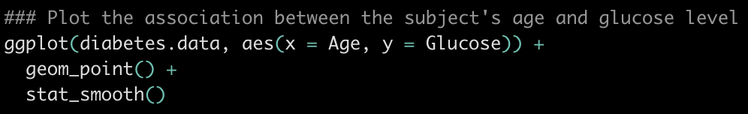
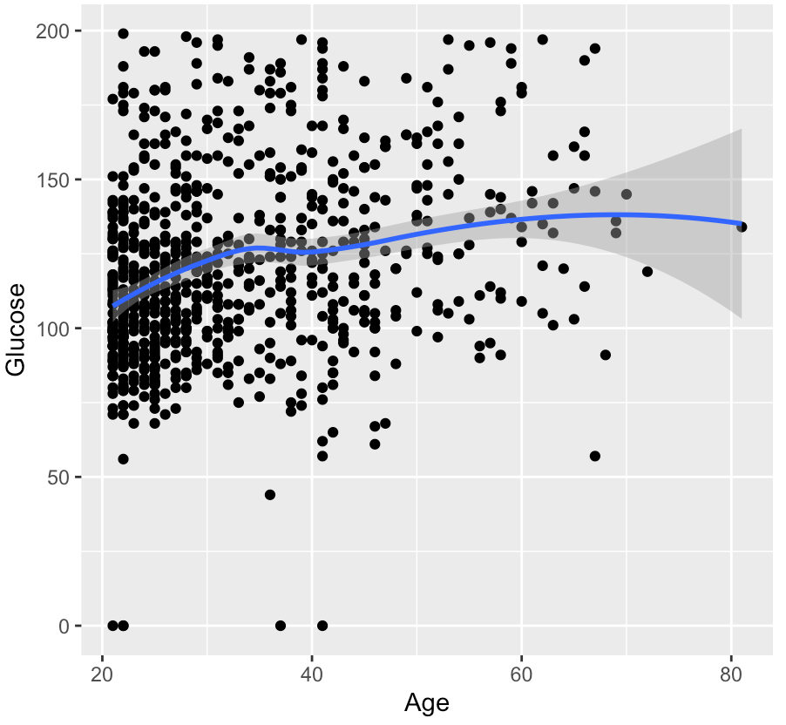
Linear regression—glucose ~ Age (2)

Slide 24



Linear regression—glucose ~ Age (3)
Is Age associated with Glucose level?
Does a 4-unit change in Age significantly associated with the Glucose level?
The null hypothesis is, there is no statistically significant association between Age and Glucose level
$$Glucose= β_{0}+β_{1}(19)+ε$$
$$Glucose= β_{0}+β_{1}(15)+ε$$
$${∆{Glucose}_{19−15}= β}_{1}\left(19−15\right)$$

Slide 25
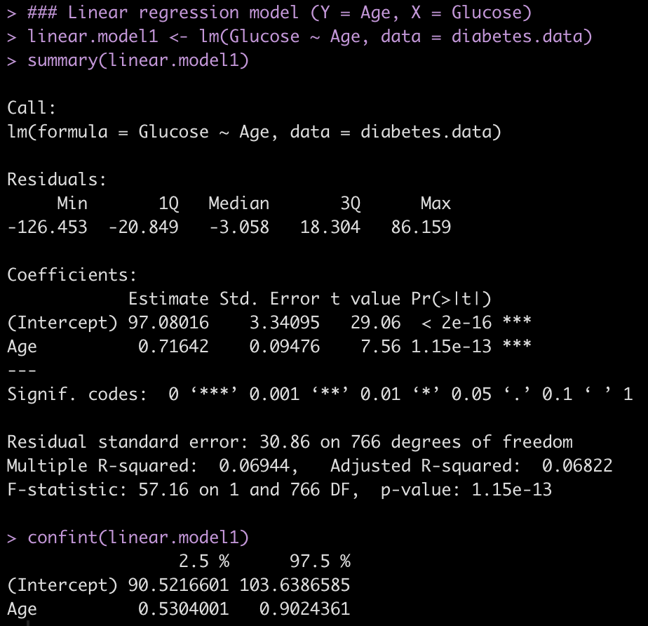
Linear regression—glucose ~ Age (4)
(Link to R tutorial)

Slide 26
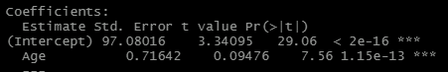









Linear regression—glucose ~ Age (5)
$$Glucose= β_{0}+β_{1}(19)+ε$$
$$Glucose= β_{0}+β_{1}(15)+ε$$
$$β_{0}=97.08$$
$$β_{1}=0.72$$
$${∆{Glucose}_{19−15}= β}_{1}\left(19−15\right)$$
Glucose level for 19-year old
Glucose level for 15-year old
$$Glucose=97.08+0.72(19)$$
$$Glucose=97.08+0.72(15)$$
$$110.76=97.08+0.72(19)$$
$$107.88=97.08+0.72(15)$$
$$110.76 −107.88=2.88$$
$${∆Glucose}_{19−15}=0.72∗4=2.88$$

Slide 27

Linear regression—glucose ~ pregnancy (1)
Is Pregnancy associated with Glucose level?
Does a 1-unit change in Pregnancy (0 → 1) significantly associated with the Glucose level?
The null hypothesis is, there is no statistically significant association between Pregnancy and Glucose level
$$E\left[Y \right|X]=β_{0}+β_{1}X+ε$$
$$E\left[Glucose\right|Pregnancy]= β_{0}+β_{1}(Pregnancy)+ε$$

Slide 28
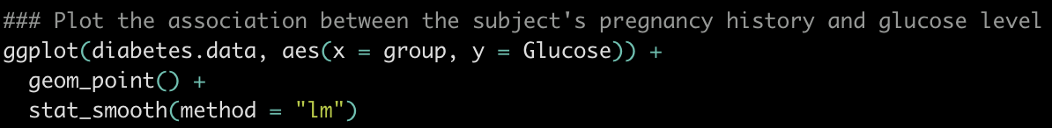
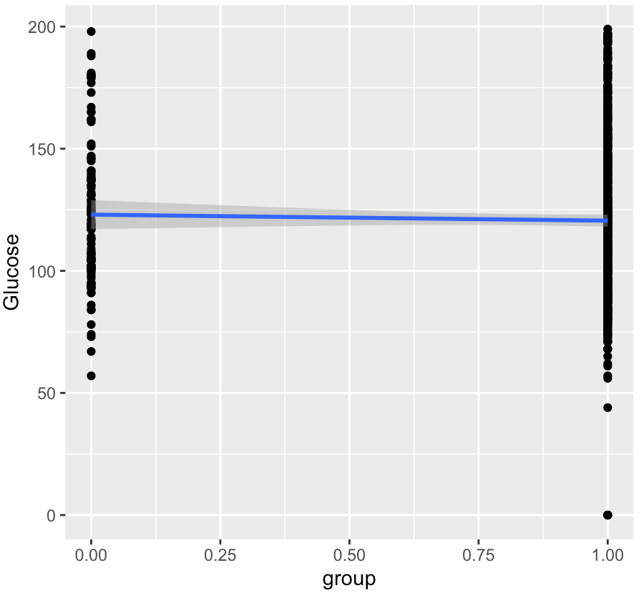
Linear regression—glucose ~ pregnancy (2)

Slide 29




Linear regression—glucose ~ pregnancy (3)
Is Pregnancy associated with Glucose level?
Does a 1-unit change in Pregnancy (0 → 1) significantly associated with the Glucose level?
The null hypothesis is, there is no statistically significant association between Pregnancy and Glucose level
$$Glucose= β_{0}+β_{1}(1)+ε$$
$$Glucose= β_{0}+β_{1}(0)+ε$$
$${∆{Glucose}_{1−0}= β}_{1}(1−0)$$
$${∆{Glucose}_{1}= β}_{1}(1)$$

Slide 30
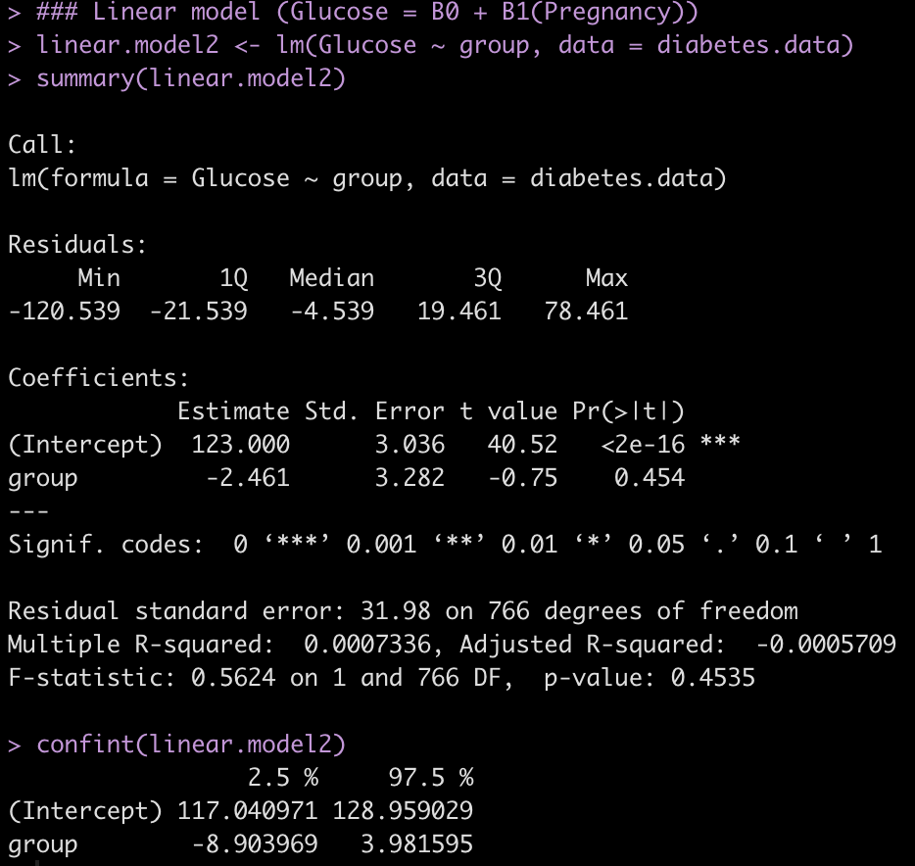
Linear regression—glucose ~ pregnancy (4)
Group represents Pregnancy and is a dichotomous variable
(0 = Not pregnant and 1 = Pregnant)

Slide 31
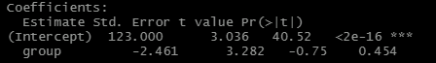









Linear regression—glucose ~ pregnancy (5)
$$Glucose= β_{0}+β_{1}(1)+ε$$
$$Glucose= β_{0}+β_{1}(0)+ε$$
$$β_{0}=123.00$$
$$β_{1}=−2.46$$
$${∆{Glucose}_{1}= β}_{1}\left(1\right)$$
Glucose level for subjects with pregnancy
Glucose level for subjects without pregnancy
$$Glucose=123.00−2.46(1)$$
$$Glucose=123.00−2.46(0)$$
$$120.54=123.00−2.46(1)$$
$$123.00=123.00$$
$120.54 −123.00=$-2.46
$${∆Glucose}_{1}=−2.46$$

Slide 32

Linear regression—glucose ~ Age + Pregnancy (1)
Is Age associated with Glucose level controlling for Pregnancy history?
Does a 1-unit change in Age significantly associated with the Glucose level controlling for Pregnancy history?
The null hypothesis is, there is no statistically significant association between Age and Glucose level controlling for Pregnancy history
$$E\left[Y\right|X]=β_{0}+β_{1}X_{1}+β_{2}X_{2}+ε$$
$$E\left[Glucose\right|Age,Pregnancy]= β_{0}+β_{1}\left(Age\right)+β_{2}\left(Pregnancy\right)+ε$$
This is an example of a multivariable linear regression model

Slide 33
Linear regression—glucose ~ Age + Pregnancy (2)
Is Age associated with Glucose level controlling for Pregnancy history?
Does a 1-unit change in Age significantly associated with the Glucose level controlling for Pregnancy history?
The null hypothesis is, there is no statistically significant association between Age and Glucose level controlling for Pregnancy history
Age
Glucose
Pregnancy history

Slide 34
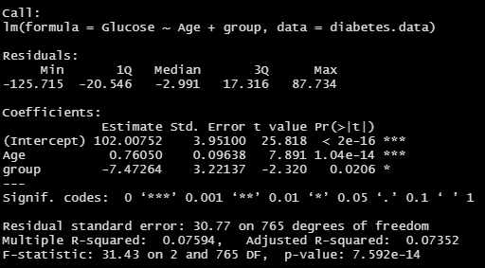
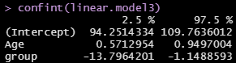

Linear regression—glucose ~ Age + Pregnancy (3)
Group represents Pregnancy and is a dichotomous variable
(0 = Not pregnant and 1 = Pregnant)
$$β_{0}=102.01$$
$$β_{1}=0.76$$
$$β_{2}=−7.47$$

Slide 35
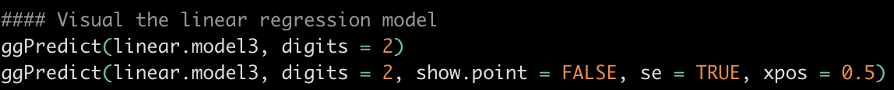
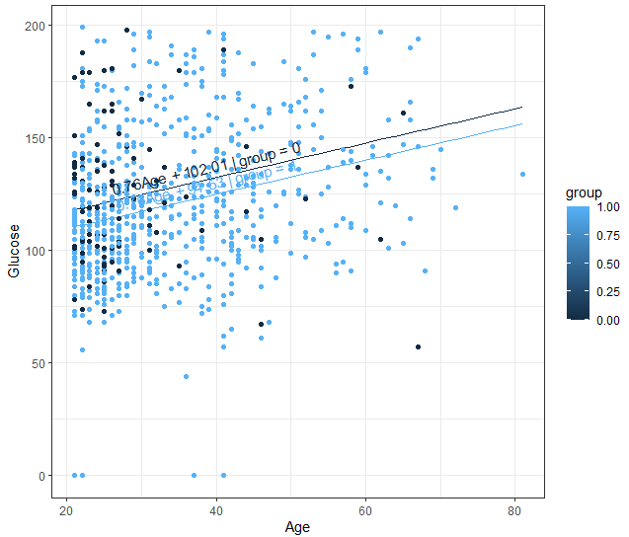
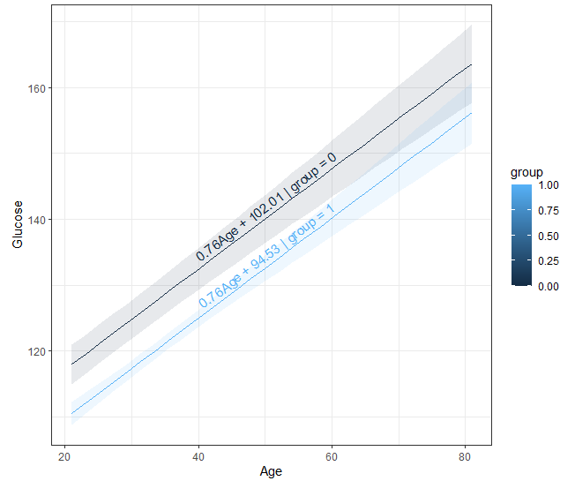
Linear regression—glucose ~ Age + Pregnancy (4)

Slide 36
Linear regression—glucose ~ Age + Pregnancy (5)
According to the linear regression model, subjects who were older by 1 year in Age had, on average, a 0.76-point increase in glucose levels (95% CI: 0.57, 0.95) controlling for Pregnancy history.

Slide 37
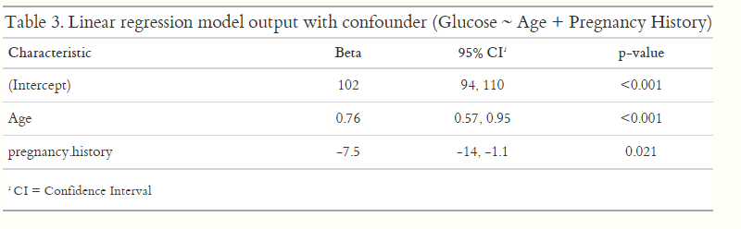
Linear regression—what does ‘controlling’ or ‘adjusting’ mean? (1)
According to the linear regression model, subjects who were older by 1 year in Age had, on average, a 0.77-point increase in glucose levels (95% CI: 0.57, 0.95) controlling for Pregnancy history.
What does “controlling” mean?
glucose | age | Preg.hx
117.3 | 30 | 1
121.1 | 35 | 1
124.9 | 40 | 1
glucose | age | Preg.hx
124.8 | 30 | 0
128.6 | 35 | 0
132.4 | 40 | 0
3.8 = 5*0.76
3.8 = 5*0.76
$$E\left[Glucose\right|Age,Pregnancy]= β_{0}+β_{1}\left(Age\right)+β_{2}\left(Pregnancy\right)+ε$$
$$Glucose=102+0.76\left(Age\right)−7.5\left(Pregnancy\right)+ε$$

Slide 38
Linear regression—what does ‘controlling’ or ‘adjusting’ mean? (2)
According to the linear regression model, subjects who were older by year in Age had, on average, a 0.77-point increase in glucose levels (95% CI: 0.57, 0.95) controlling for Pregnancy history.
What does “controlling” mean?
glucose | age | Preg.hx
117.3 | 30 | 1
121.1 | 35 | 1
124.9 | 40 | 1
glucose | age | Preg.h
124.8 | 30 | 0
128.6 | 35 | 0
132.4 | 40 | 0
-7.5 = -7.5
-7.5 = -7.5
$$E\left[Glucose\right|Age,Pregnancy]= β_{0}+β_{1}\left(Age\right)+β_{2}\left(Pregnancy\right)+ε$$
$$Glucose=102+0.76\left(Age\right)−7.5\left(Pregnancy\right)+ε$$

Slide 39
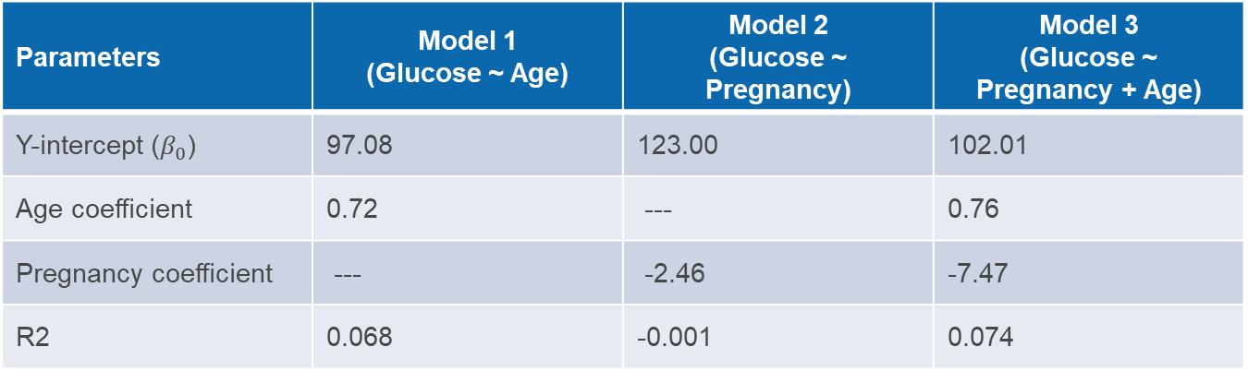
Model comparisons
Parameters | Model 1 (Glucose ~ Age) | Model 2 (Glucose ~ Pregnancy) | Model 3 (Glucose ~ Pregnancy + Age)
Y-intercept ($β_{0}$) | 97.08 | 123.00 | 102.01
Age coefficient | 0.72 | --- | 0.76
Pregnancy coefficient | --- | -2.46 | -7.47
R2 | 0.068 | -0.001 | 0.074
$$Model 1: E\left[Glucose\right|Age]= β_{0}+β_{1}(Age)+ε$$
$$Model 2: E\left[Glucose\right|Pregnancy]= β_{0}+β_{1}(Pregnancy)+ε$$
$$Model 3:E\left[Glucose\right| Age, Pregnancy]= β_{0}+β_{1}\left(Age\right)+β_{2}\left(Pregnancy\right)+ε$$

Slide 40
Controlling for confounding
https://www.explainxkcd.com/wiki/index.php/2560:_Confounding_Variables

Slide 41
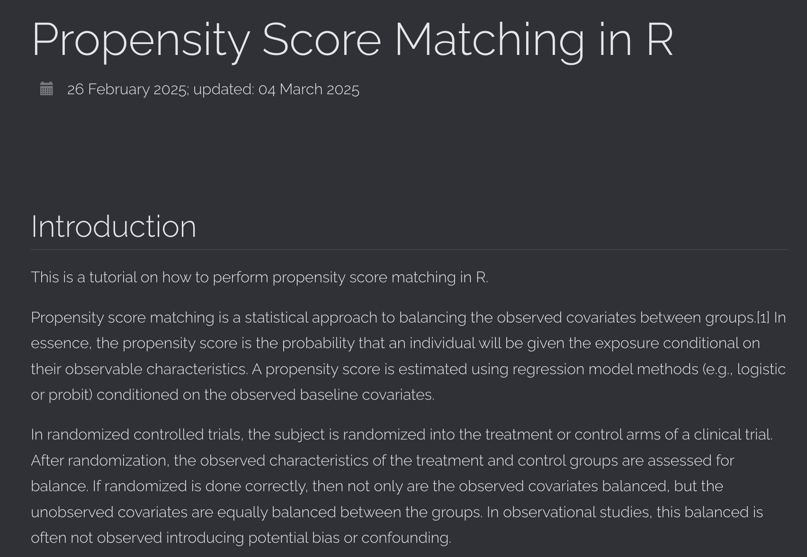
Another method to address confounding
Propensity score matching
(R Tutorial on propensity score matching methods)

Slide 42

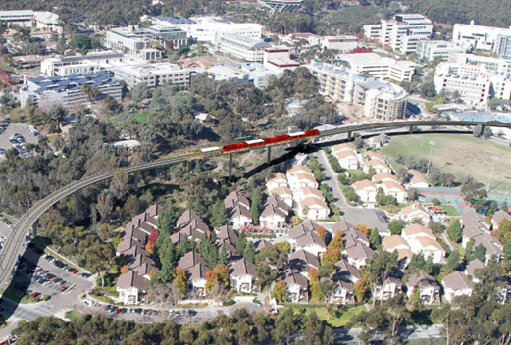
ADDITIONAL RESOURCES
Linear Regression Chapter: Learning Statistics with R (book)
Linear Regression in R tutorial
Propensity score matching in R tutorial

